Slide 1
ORGANIC FARM
By:
Dhanushya.G

Slide 2
CONTENTS
ABSTRACT
INTRODUCTION
SYSTEM REQUIREMENTS
MODULES
ADVANTAGES
SCREEN SHOTS
CONCLUSION

Slide 3
ABSTRACT
Organic Farm is an online store which is used to buy the products which was cultivated by the method of organic farming. In ancient times, agriculture was practiced without the use of artificial chemicals. The use of artificial chemicals such as fertilizers and pesticides came into practice during the mid-19th century. this kind of agricultural practice was causing harm to the environment. with the rapid change in farming practices, organic farming came into existence in the 20th century. It made use of environment friendly practices by avoiding the use of artificial chemicals and making use of organic matter to raise crops. Organic food is beneficial to human health and the practice of organic farming keeps the environment clean.

Slide 4
INTRODUCTION
Organic farming is an alternative to regular farming. It makes use of compost, manure, green manure, bone meal rather than using fertilizers and pesticides . This system makes use of organic wastes and crops are raised in such a manner that it keeps the soil healthy and alive. Microbes are used as bio-fertilizers to increase production without polluting the environment. Organic farming promotes eco-friendly agricultural practices without making use of synthetic inputs and majorly relies upon the use of organic wastes to raise crops.

Slide 5
SYSTEM REQUIREMENTS
SOFTWARE REQUIREMENTS:
1.Operating System - Windows 10.
2.Platform – Notepad++.
3.Language – HTML, CSS.

Slide 6
MODULES
Login
Home page
About page
Services
Products
Contact us
Feedback

Slide 7
ADVANTAGES
Production cost is low
Protects environment from pollution
Slow downs global warming
Fruits and vegetables are more nutritious and tastier.

Slide 8

SCREEN SHOTS
LOGIN PAGE:

Slide 9
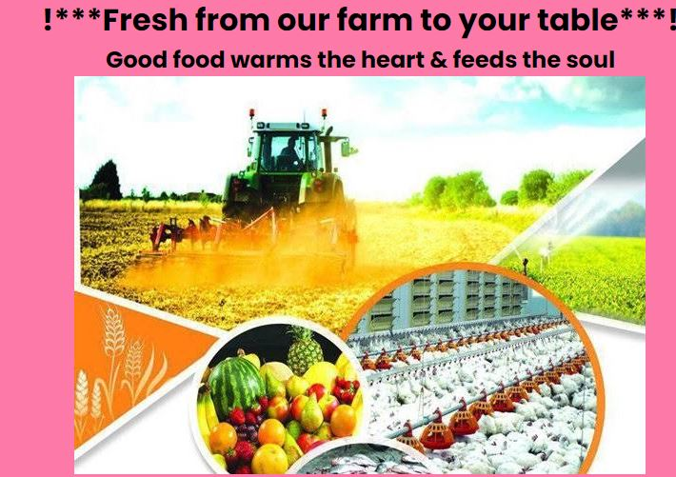
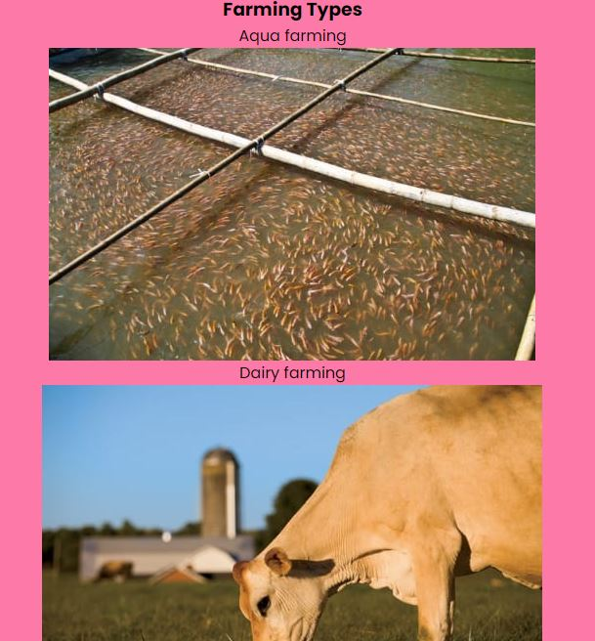
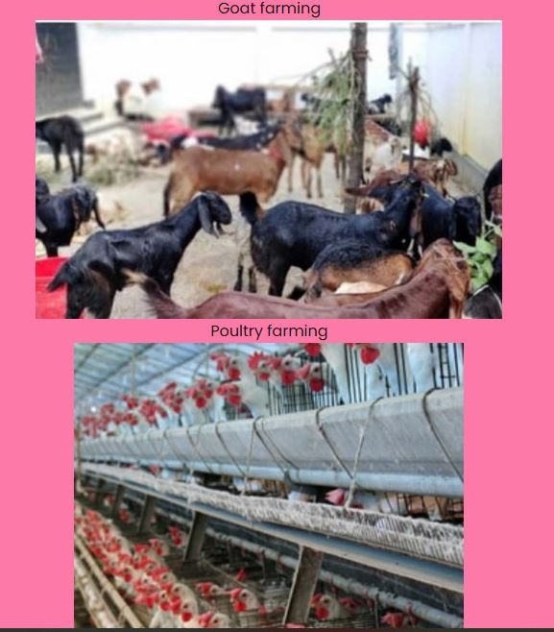
HOME PAGE:

Slide 10
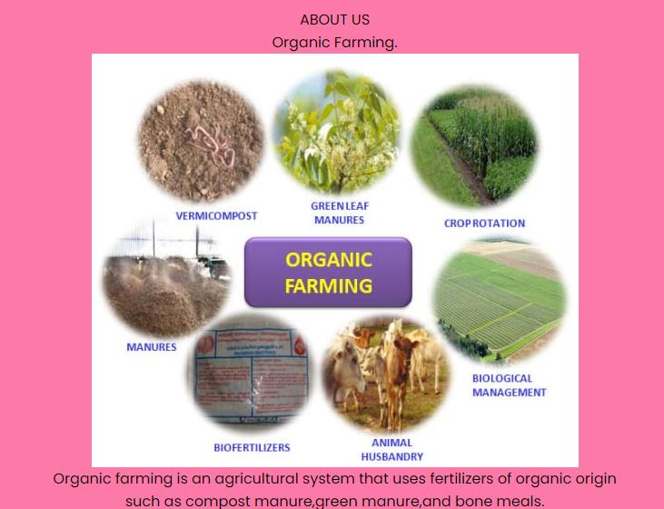
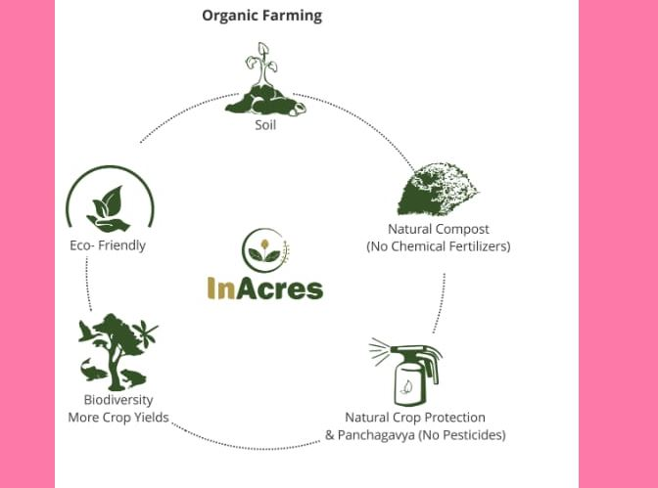
ABOUT PAGE:

Slide 11

SERVICES:

Slide 12

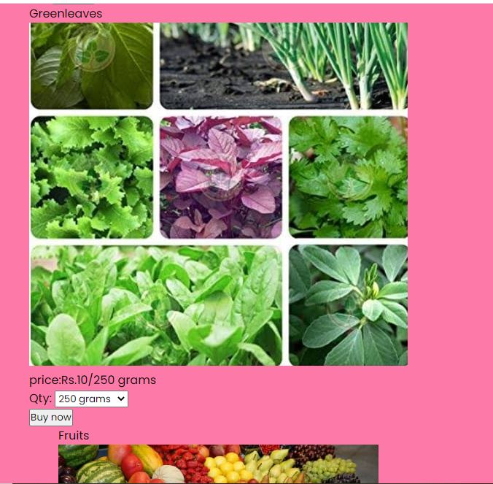

PRODUCTS:

Slide 13

CONTACT US:

Slide 14

FEED BACK:

Slide 15
CONCLUSION:
Organic farming is a great alternative to conventional farming practices. It follows eco-friendly agricultural practices without making use of harmful chemicals. It helps in maintaining human health as well as protects our environment from harmful chemicals used to raise crops in a field. Going organic is a great way of preventing chemicals and protecting our health and environment but there are a lot of challenges in this field. Due to the high price of organic food, people are not yet accepting the use of organic food. The other challenge in the field of organic farming is to meet the world’s demand for food as the growth of organic crops is slow .

Slide 16
Thank you

